Slide 1
Lecture # 7
CSC336 Web Technologies
Credit Hours: 3(2, 1)

Slide 2
CSS

Slide 3
CSS Introduction
What is CSS?
CSS is the language we use to style a Web page.
CSS stands for Cascading Style Sheets
CSS describes how HTML elements are to be displayed on screen, paper, or in other media
CSS saves a lot of work. It can control the layout of multiple web pages all at once
External stylesheets are stored in CSS files

Slide 4
CSS Syntax
A CSS rule consists of a selector and a declaration block.
Selector Declaration
h1 {
color: red;
text-align: right;
}
Example
p {
font-family: Arial; font-size: 20px;
}
Property
Value

Slide 5
Common CSS Properties
color
text-align
font-family, font-size, font-weight
width, height
margin, padding
border
. . .

Slide 6
How To Add CSS
Three Ways to Insert CSS
There are three ways of inserting a style sheet:
External CSS
Internal CSS
Inline CSS

Slide 7
Example: Inline CSS
style.html
<h1 style="color: blue; text-align: center;">Hello</h1>
<body style="color: blue; text-align: center;">
<h1 | style="color: | blue;">Hello</h1>
<h1 | style="color: | red;">Hello</h1> | <!-- | springgreen | -->

Slide 8
Typeface (Font Family)
A typeface is a distinctive design that's common to any related set of letters, numbers and symbols.
What’s the difference between a typeface and a font?
o the two terms are interchangeable.
Font: A font is a particular implementation of a typeface, meaning the
typeface as rendered with a specific weight, size and style.
Typeface: The typeface gives each character a shape and thickness that's unique to the typeface
Helvetica is a typeface; bold 16-point Helvetica is a font.
font: weight + size + typeface
Example:
font: bold 40px sans-serif;

Slide 9
Typeface (Font Family)
Serif fonts have a small stroke at the edges of each letter. These
subtle appendages give the typeface a traditional, classy look, but they can get lost when displayed on a screen at small sizes.
Sans-serif fonts have clean lines (no small strokes attached). They
create a clean modern and minimalistic look that’s well suited to
screen text, particularly at small sizes.
Monospace fonts - here all the letters have
the same fixed width, so skinny letters such
as i and l take up as much space as wider
letters such as m and w. They create a mechanical look.
4. Cursive fonts are designed to resemble human
handwriting e.g. handwritten pen or brush
writing.
5. FANTASY FONTS ARE DECORATIVE/PLAYFUL FONTS

Slide 10
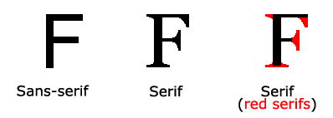
Difference Between Serif and Sans-serif
Note: On computer screens, sans-serif typeface are considered easier to read than serif font family.

Slide 11
Font Selection is Important
Typeface | Uses
Serif | works best for headings and other text set at large sizes;
Sans-serif | makes good body text
Monospace | works well for code listings
Cursive | best for short bits of text that require elegance or playfulness e.g. scripts
Fantasy | should be used only when a special effect is required (such as being extra thick).

Slide 12
Example: External CSS
h1 {
color: blue; text-align: left;
font-family: Arial, sans-serif; font-size: 28px;
font-weight: normal;
}

Slide 13
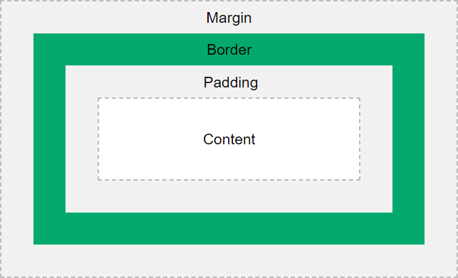
CSS Box Model
All HTML elements can be considered as boxes.

Slide 14
Table Border
table {
border: 1px solid black; border-collapse: collapse;
}
td, th {
border: 1px solid black; padding: 5px;
}

Slide 15
Identifying Elements
div
span
id
class

Slide 16
<div>
Hello, World!
</div>
div {
background-color: orange; <!-- blue -->
width: 200px; <!– 100px --> height: 200px; <!– 400px --> padding: 20px;
margin: 20px;
border: 3px dashed black;
}

Slide 17
ID, class
<body>
<h1 id="foo">Heading1</h1>
<h1 id="bar">Heading2</h1>
<h1 class="baz">Heading3</h1>
</body>
#fo
#bar
.baz

Slide 18
Example leading to Specificity
h1 {
color: red;
}
#foo {
color: blue;
}

Slide 19
Specificity (Precedence)
inline
id
class
type

Slide 20
Specificity
<div id="foo">
Hello!
</div>
Hello!
div {
color: blue;
}

Slide 21
Specificity
<div id="foo">
Hello!
</div>
Hello!
div {
color: blue;
}
#foo {
color: red;
}

Slide 22
Specificity
<div id="foo">
Hello!
</div>
Hello!
#foo {
color: red;
}
div {
color: blue;
}

Slide 23
Lesson Learning Outcome (LLOs)
CSS rule
Common CSS Properties
Inline Vs Internal Vs External CSS
Typeface Vs Font
CSS Box Model
Specificity

